Slide 1
Eye Movement based Human Identification
Submitted To :
Dr Vivek Srivastava
Department Of CSE,RECK
Submitted By :
Shubham Verma
1683910042

Slide 2
Contents
Literature Review
Algorithms and Concepts Involved
Former Research Algorithms
Tactics And Problem Formulation
Decision Parameter Analysis
Future Scope And Applications
Project details
Conclusion

Slide 3
Introduction To Project
The need for accurate and unforgeable identity recognition techniques has become an issue of increasing urgency
Project seeks to advance our knowledge of security and accuracy of multibiometric systems.
By inventing, evaluating, and applying innovative methods and tools to combine highly accurate static traits, such as iris patterns, with novel traits based on the dynamics of eye movements.
The strategy is to use existing iris recognition hardware to combine three different biometrics approaches related to the eye: measurement of iris patterns, unique characteristics of the eye globe and its muscles, and the brain’s strategies for guiding visual attention.
This multimodal ocular biometrics approach has the potential to improve liveness detection and resistance to sophisticated counterfeiting techniques and coercion attacks, while improving identification accuracy.
This research tackles important questions related to the individuality, variability, scalability, and longevity of these ocular traits, building a foundation for security and accuracy improvement when those traits are combined with iris recognition.

Slide 4
1) Oleg V.Komogortsev 2016 Elsivier Analysis Of Bio-Eye : Research Eye Movement Biometrics
Introduction And Historic Approach :
Human Oculomotor System – Responsible for Eye Movement Co-ordination For Filtering : Functionality – 6 Occular Muscles – 4 of which for vertical and Horizontal Movement – 2 for Tortional Rotational Of eye.
Then later on In Second half of 20th Cen. Visual Scanning Techniques and Information Processing – Application is to enhance the speed and accuracy of Traditional Pointing Devices.
Later Research by Andrews and coppola Certain Characteristics : Fixation Duration and Saccadic Size – Use to get affected by Endogenous Factors.
Uses – Pattern Viewing , Absence Of Visual Stimulation – Dark Room and Reading the Visual Searches.

Slide 5
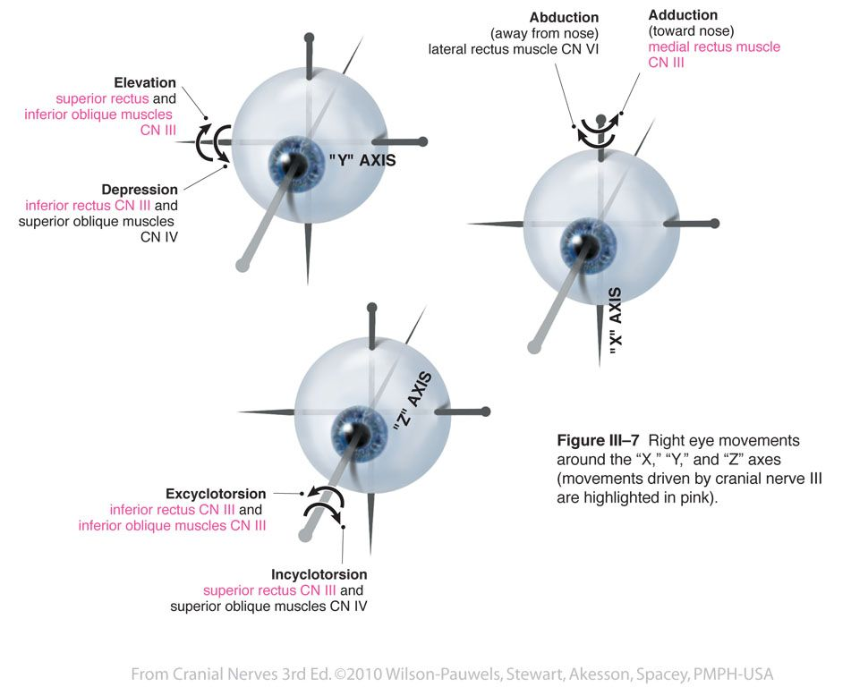
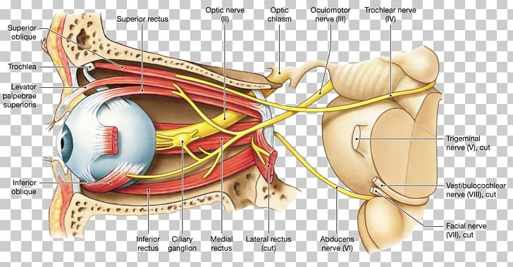

Slide 6
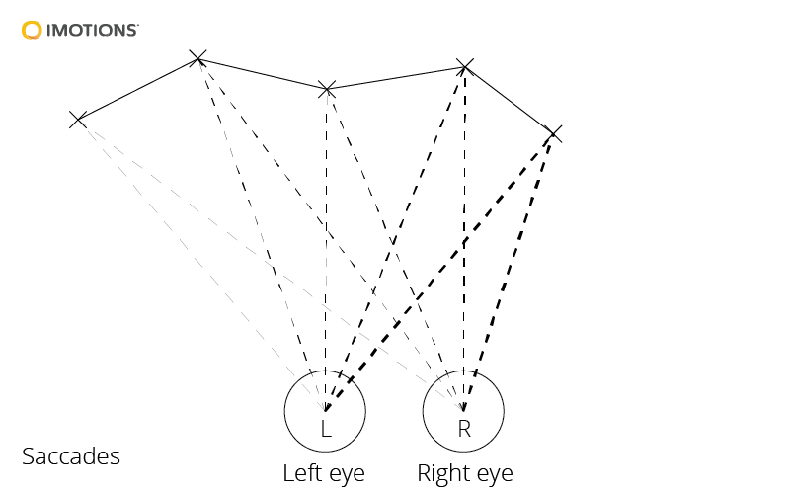
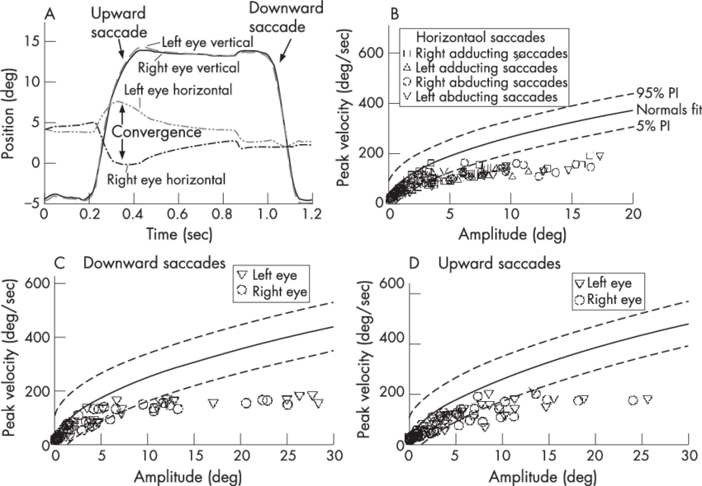
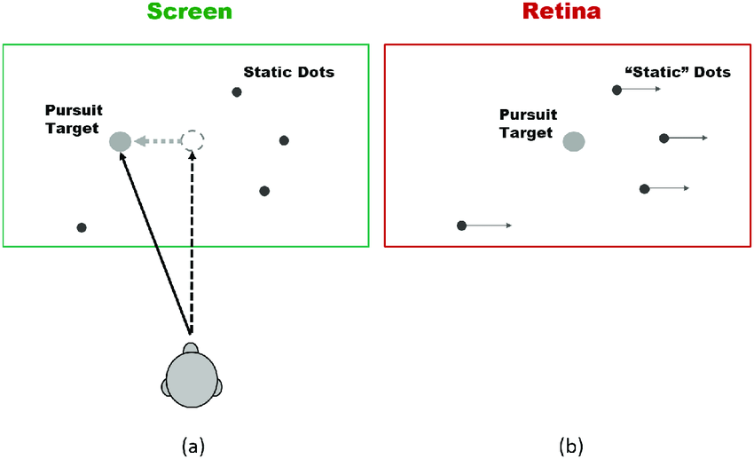
Saccade Eye Movement
Rapid Movement Of eye in Between the two Fixed Points And based upon the Fixation Parameters.

Slide 7
Authors and year | Used features | Visual stimuli | Eye tracker
Kasprowski and Ober [29], 2004 | Cepstrum transform | “Jumping”-point-of-light | Ober 2
Bednarik et al. [30], 2005 | FFT/PCA on pupil diameter/variation, eye distance, gaze velocity | “Static” cross | Tobii 1750
Silver and Biggs [31], 2006 | number of fixations, fixation duration, saccadic velocity/duration, gaze position | “Reading while typing” | LC Technologies Eyegaze
Kinnunen et al. [32], 2010 | Gaussian mixture models on histograms of velocity directions in short-term windows | Text, video | Tobii X120
Komogortsev et al. [33,34], 2010, 2012 | characteristics of the Oculomotor Plant Model | “Jumping”-point-of-light | Tobii X120, EyeLink 1000
Holland and Komogortsev [35,36], 2011, 2013 | fixation number/duration, saccadic amplitude/velocity, scanpaths | “Jumping”-point-of-light, Rorschach images, cognitive dot patterns, text | Tobii TX300, EyeLink 1000, Playstation cam
Cuong et al. [37], 2012 | Mel-frequency Cepstral Coefficients on eye: position, difference, velocity | “Jumping”-point-of-light | Ober 2
Rigas et al. [39,40], 2012 | Wald–Wolfowitz runs test on graph-based representations of fixation points | Face images, “jumping”-point-of-light | CRS, Ober2
Liang et al. [41], 2012 | acceleration, geometric, and muscle properties of the eye movements | Video clips of a moving white ball | Tobii X120
Zhang and Yuhola [42], 2012 | saccadic amplitude, accuracy, latency, velocity and acceleration | “Jumping”-point-of-light | Visual Eyes, Micromedical Technologies
Holland and Komogortsev [43], 2013 | fixation duration/position/velocity, saccadic amplitude/duration | Text | EyeLink 1000, Playstation cam
Komogortsev and Holland [44], 2013 | saccadic dysmetria, compound saccades, dynamic overshoot, express saccades | “Jumping”-point-of-light | EyeLink 1000
Rigas and Komogortsev [45], 2013 | probabilistic maps of attention - fixation density maps | Video | EyeLink 1000
Yoon et al. [47], 2014 | Hidden Markov models on gaze velocity | Cognitive-dot stimuli | Mirametrix S2
Cantoni et al. [48], 2015 | Frobenious norm on graph representations of fixation points using density/duration weights | Faces images | Tobii 1750
Rigas et al. [49], 2015 | Multi-source weighted fusion scheme using methods [34,43,45] | “Jumping”-point-of-light, text, video | EyeLink 1000

Slide 8
Bio Eye – 2015
1. Selection of visual stimuli
The eye movements can encapsulate both physiological and cognitive characteristics. Thus, the different eye movement biometric methods developed in the past employed different types of visual stimuli
• “Jumping”-point-of-light (horizontal, vertical, and random)
• Cognitive-dot patterns
• Text excerpts
• Face images
• Various-content (natural) images
• Video sequences
2. Experimental Setup
Capture The Environment
Lab Controlled and Open Free Environment
Eye Tracking Apparatus
Recording Process and Calibrations
Assessment Of Data Quality : Calibration Accuracy and Validation
Direct Processing and Fixation Saccades

Slide 9
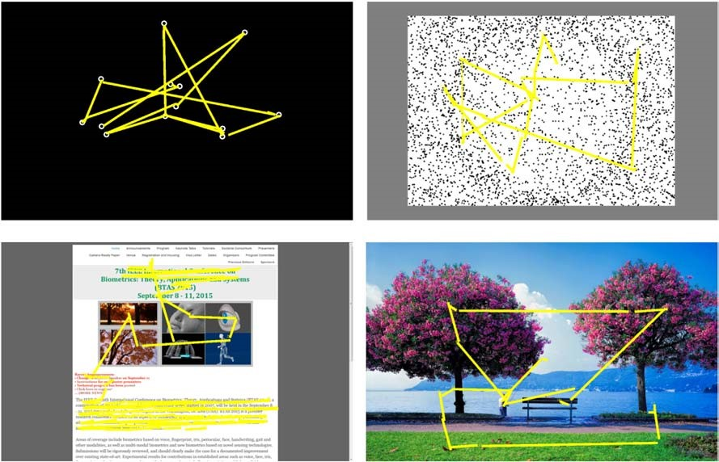
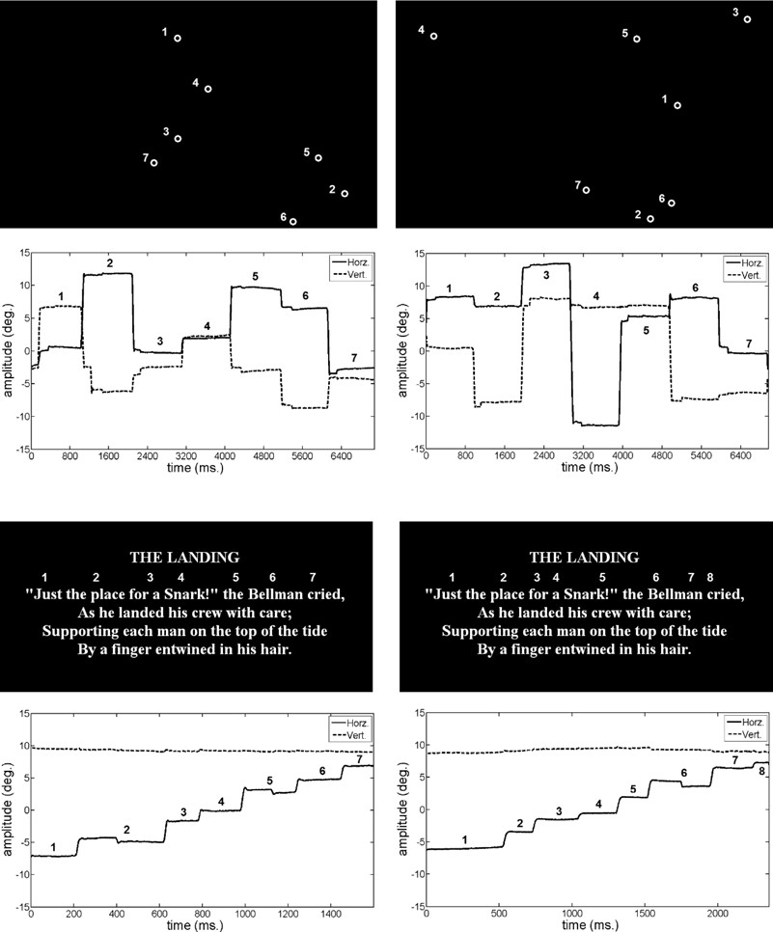
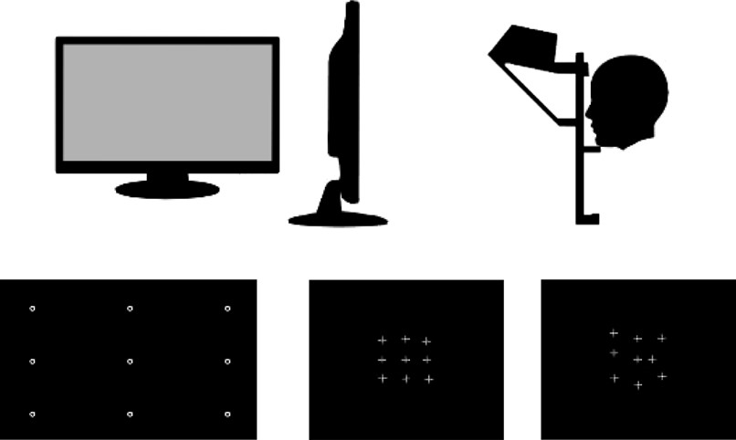
550
mm
474
mm
Subject ID:037
Subject ID: 175
pixels
1680
pixels
297
mm
effective
1050
visual field
(
a
)
calibration points (all)
‘good’ calibration map
‘bad’calibration map
Subject ID:001
Subject ID:011

Slide 10
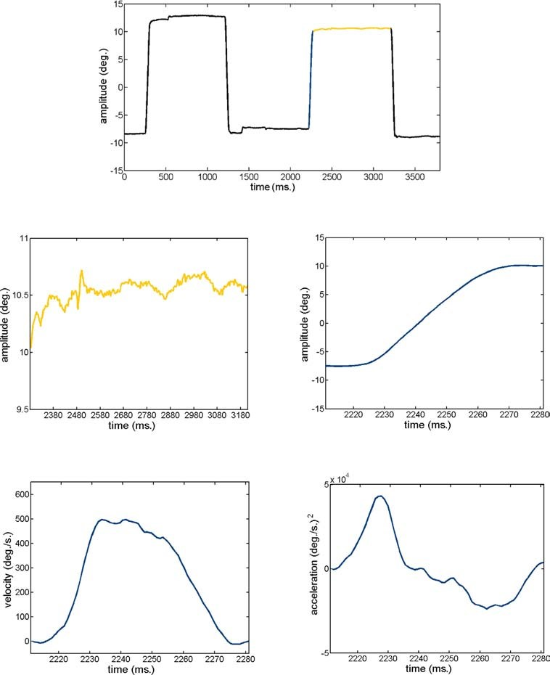
fixation
saccade
fixationamplitude profile
saccadic amplitude profile
duration
amplitude
duration
.
saccadic velocity profile
Amplitude
saccadic acceleration profile
peak
acceleration
peak
velocity
peak
deceleration

Slide 11
2. Towards Multi-Source Fusion Approach for Eye Movement Driven Recognition – Oleg Komogorstev – Elsivier 2016
Introduction And Scope Of Information Fusion
Numerous Benefits can be availed in the domain of Biometric Recognition by information fusion strategy.
Performance Gain in the context of Biometric Accuracy is Enhanced.
Ease Of Selection and Promotion of Informative Features from different modalities.
Work Presented by Hong And Jain gives us the clear idea of Multi –modal Fusion Scheme for finger print and face cues.
Work illustrated by Vasta El Al gives us the clue of multiple fusion algorithms in different stages of recognition process.
He gave Multi Algorithmic Fusion Evaluated for Face Biometrics
Work by Jang Et al proposed fusion approach for iris Biometrics.
Fusion Of Single or multiple modalities is categorised in the form of Processing Levels :
Sensor Levels : Optical and Capacitive Sensors
Feature levels : Feature Vectors
Matching Score Level : Comparisons Score
Decision Levels

Slide 12
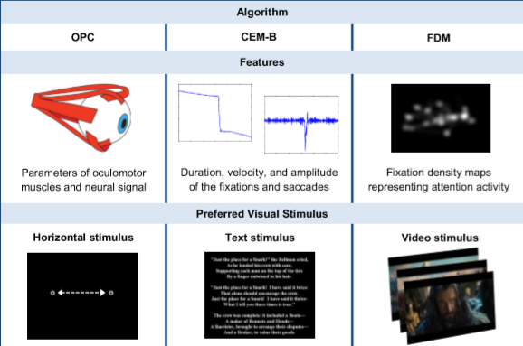
Approach : Fusion Algorithms
OPC Algorithm : Oculomotor Plant Characteristics
CEM-B Algorithm: Complex Eye Movement Behaviour ( Physical and Behavioural )
FDM Algorithm : Fixation Density Maps
Selection Of Algorithms Depends upon Variety Of Sources, Whether they exihibit Stimulus Preference and Whether selected parameters explores the scenario of eye movement based Characteristics.

Slide 13
3. OPC Algorithm 2016
Based On Mathematical Model describing Oculomotor System’s Operation
Main Operation Includes : Simulation Of Saccadic Eye Movement & thereby Comparing them With actual trajectory by real eyes of user.
Algorithm deals with minimisation of the f(n) in context of no of parameters.
Parameter Model Characteristics :
Series Elasticity
Length Tension Relationship
Tension Slope
Force – Velocity Relationship
Inertial mass
Deactivation mass
Neural Pulse Width
Tension Intercept
Conclusion : It States The Comparison using Multi-Variate Hotelling T2 Test Send Directly to input source.

Slide 14
4. CEM-B & FDM –B 2016
Developed For Extraction Of Biometric Features during Complex Tasks as Reading text.
It can Model various eye fixation and Saccades.
Extracted Features : Fixation Time , Fixation Centroid , Saccade Start time , Saccade Duration , Saccade Peak Velocity.
For Each Eye biometric Template is Calculated X = { X1(m),X2(m)………… Xn(m) }
For the Final Comparison Score Cem[m] is given out.
This Score is Transmitted to the Input for Multi source Fusion.
In Fixation Density Maps Biometrics , Works by extracting features for representation of attention dependent strategies of eye Movement in Dynamic Changing Stimuli.
For each eye Xfdm is Calculated by mapping its Sequence to n- Fixation Density Maps Xi ( 2D grayscale images ) Defined for capacities Sequential time interval.
Scores are then validated and then its final Summation of X1,X2, .. Xn is computed to impart the Final Score Cfdm to the input of Muti Source Fusion Algorithms.

Slide 15
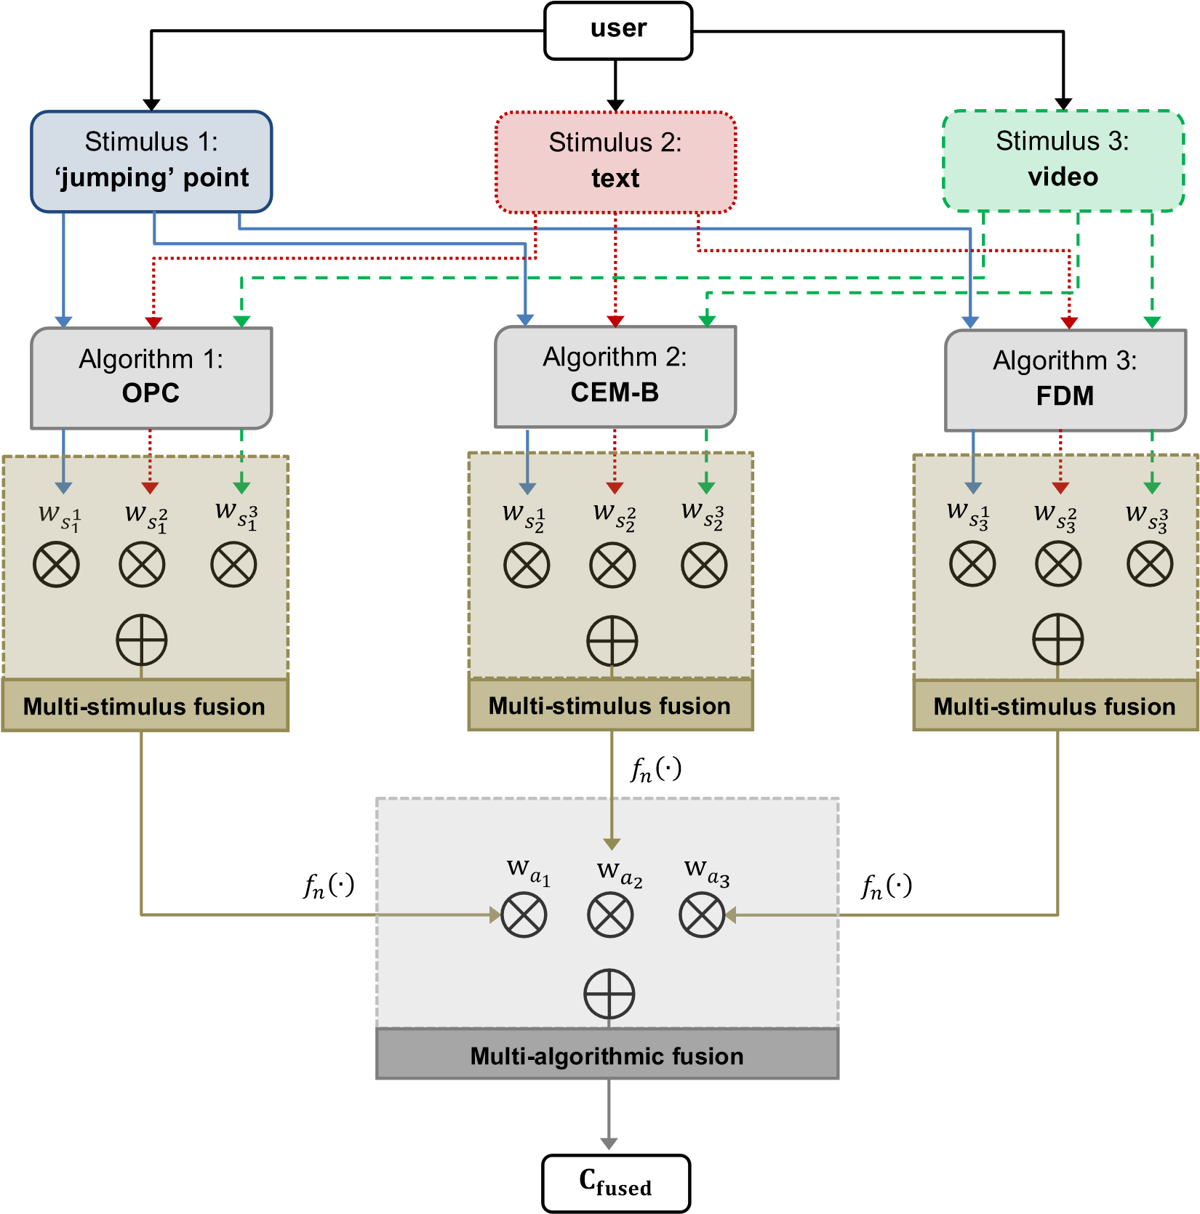
Multi Source Fusion Algorithm

Slide 16
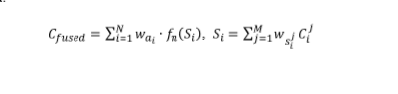
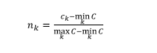
Fusion Algorithm
Assumption : user Observes Different Stimuli , Visual Stimuli are presented to the user Sequentially in time gap.
First Stage deals with Each algorithm extracts no of features ad corresponding Biometric Templates.
Then comparison of Templates Using stimuli Fusion Specific Weights.
Optimum Weight Training Methods Used to Quantify the performance and generalisation.
During Second stage Info Fusion takes place by algorithm specific weights that needs to be normalised by Normalisation Function.
Multi Fusion Equation :
Maximum – Min Normalisation :

Slide 17

Computation Decision
It is based Upon Multi Fusion Weights on the basis of ranks

Slide 18
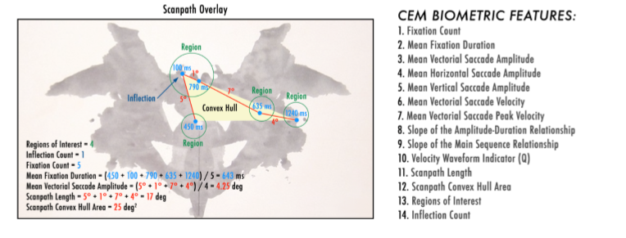
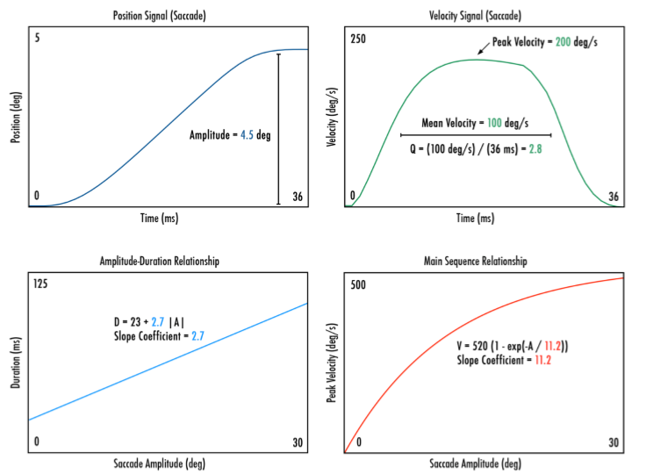
5 . IEEE Transaction : Complex Biometrics In Eye-Oleg 2015

Slide 19
6. IEEE Transaction : 2018 – Wavelet Method for automatic Detection Of Eye Movement Behaviour
In this Novel Eye movement data filtering and eye movement Classification algorithm is proposed.
Non Linear Wavelet Threshold Denoising Method was used to smooth the eye movement data and detect saccades in the presence of smooth eye movements.
Behaviours are associated to the different Characteristics of Wavelet Detailed Coefficients.
Experiments are conducted based on Wavelet Algorithm to compare eye movement Signals.
Simulations Further shows Eye movement data Filtering based On Wavelet has better performance metrics than other previously researched Filters.
Further Classification algorithm is used to classify eye movement behaviours based on Wavelet.
Later Tracking Technology is used to record and analyse the user eye movement during the test to get their Psychological and Cognitive state of the respective user.
With the above modalities this algorithm and paper turned to be efficient than the previous algorithms.

Slide 20
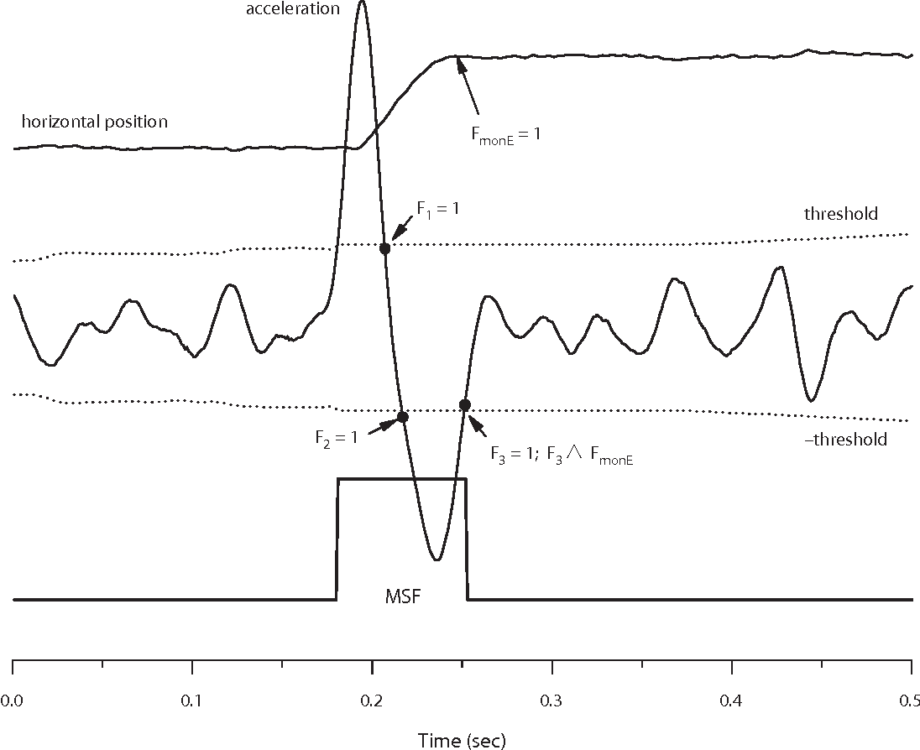
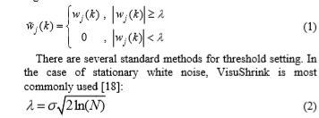
A . Wavelet as Eye Movement Data Analysis
Stationary Wavelet Transform SWT is used for discrete Wavelet Transform
Results are not down-stamped for the convenience to extract the requisite data
Wavelet Coefficient Characteristics For Different Eye Movements
X co-ordinate represents 2D Eye movement signals.
Waveforms of Fixation are stable.
Transaction Between two states is stable.
Spikes could affect the detection coefficients.
C. Eye Movement Denoising Based On Wavelet
Levels Of SWT = Wj[k] , k=1,2…….n
Thresholding Formulation : N : Wavelet Decomposition L

Slide 21
Project

Slide 22
Objectives
Facilitate Interaction and sharing of Information among Police Departments, Districts, State/ headquarters and other Police Agencies.
Improve delivery of citizen-centric services through effective usage of IRS.
Provide the Investigating Officers of the Civil Police with tools, technology and information to facilitate investigation of crime and detection of criminals.
Improve functioning in various other areas such as Law and Order, Traffic Management etc.
Reduce manual and redundant Records keeping
Make the department functioning citizen friendly and more transparent by automating the functioning of Departments.
To Maintain one placed Computerized Criminal Record and can be used to verify identity in Government Organization.

Slide 23
Proposed Software
The proposed system includes the following features:
Login for user and admin
Upload iris images to train the system
View upload images
Recognition using iris images : Using Open CV 2.4.9
Algorithm Used : SIFT – Scale Invariant feature Transform
Register feedback
View feedback

Slide 24
Terminologies Used
Java JDK 1.6
Backend and frontend : Servlet & JSP
Database : My SQL 5.0
Eclipse Tool : Eclipse Indigo
Iris Scanning Tool : OpenCv 2.4.9 ( SIFT Algorithm )
Design Pattern : MVC
Machine Learning + Artificial Intelligence + Biometrics

Slide 25
Admin Modules
Login
profile
Category
Add category
Edit Category
Delete Category
Upload Image
Select the Image
Write name address and upload
View Image
Select Category
View Image
User List
Change Password
Logout

Slide 26
User Module
Login
User Profile
Search Image
Select Image
Start Searching
Displaying Result
Register Feedback
View Feedback
Change Password
Sign Out

Slide 27


Slide 28


Slide 29
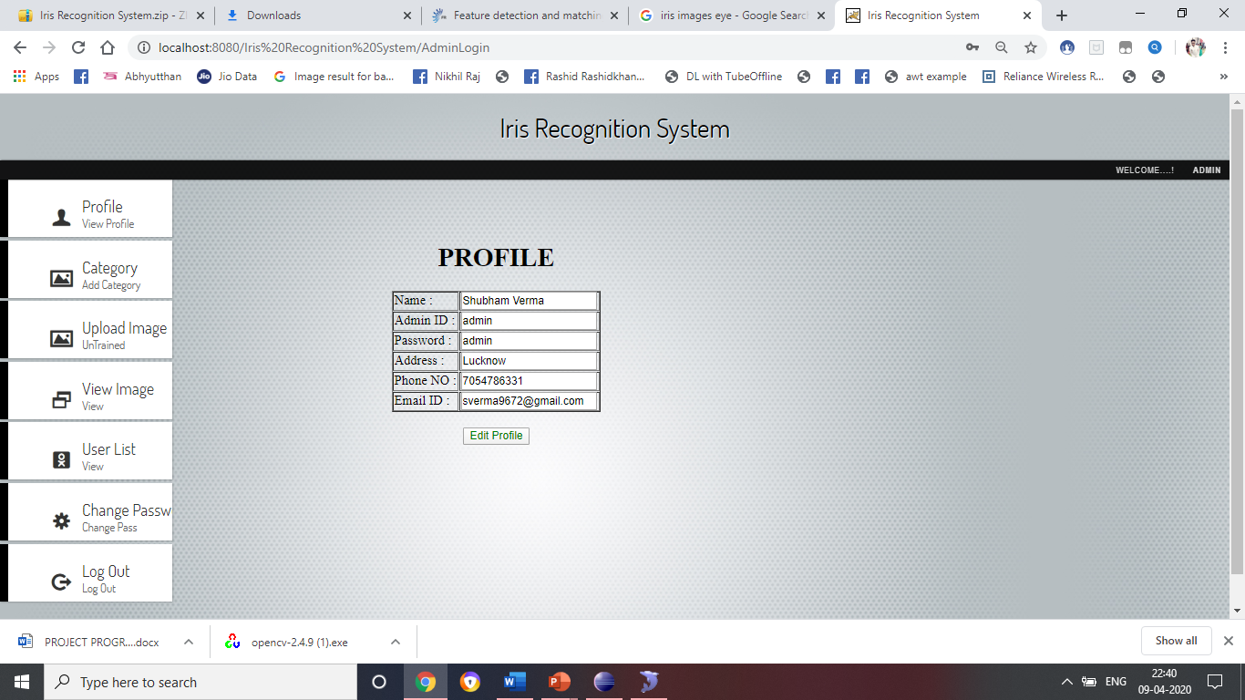

Slide 30
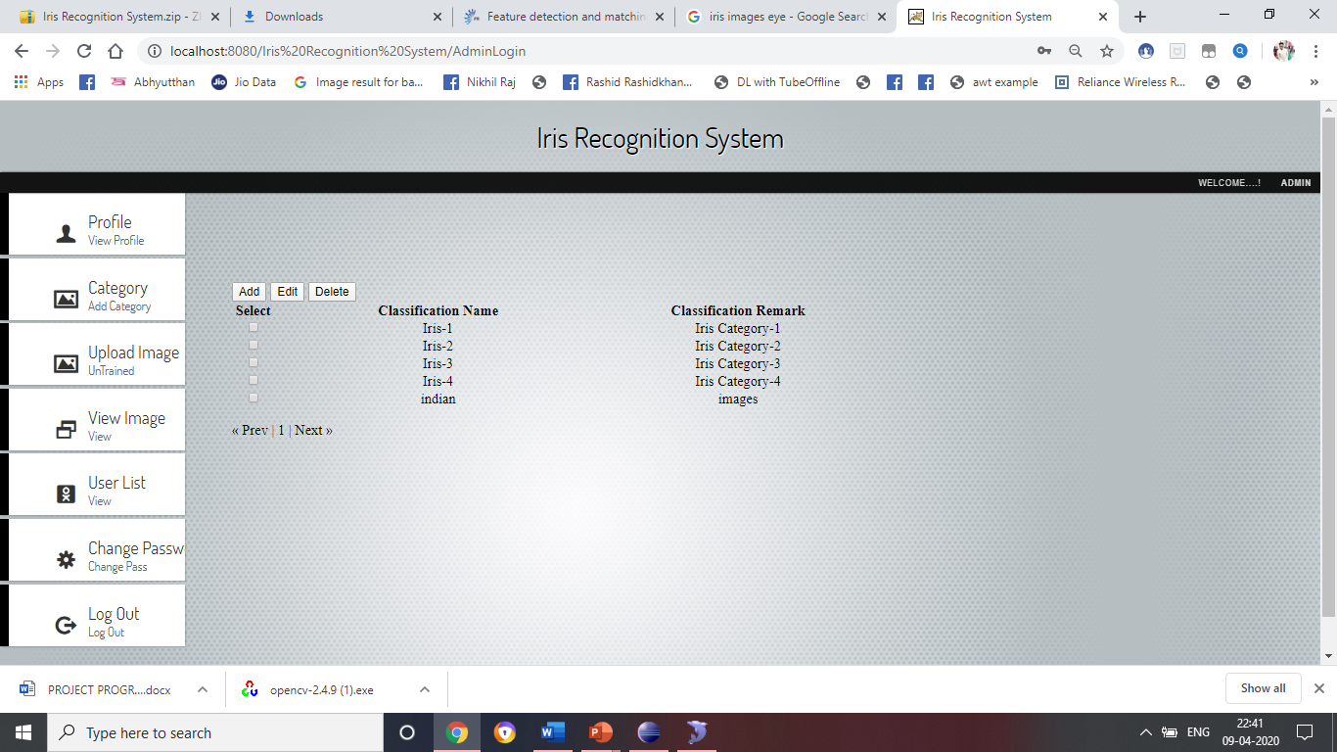

Slide 31
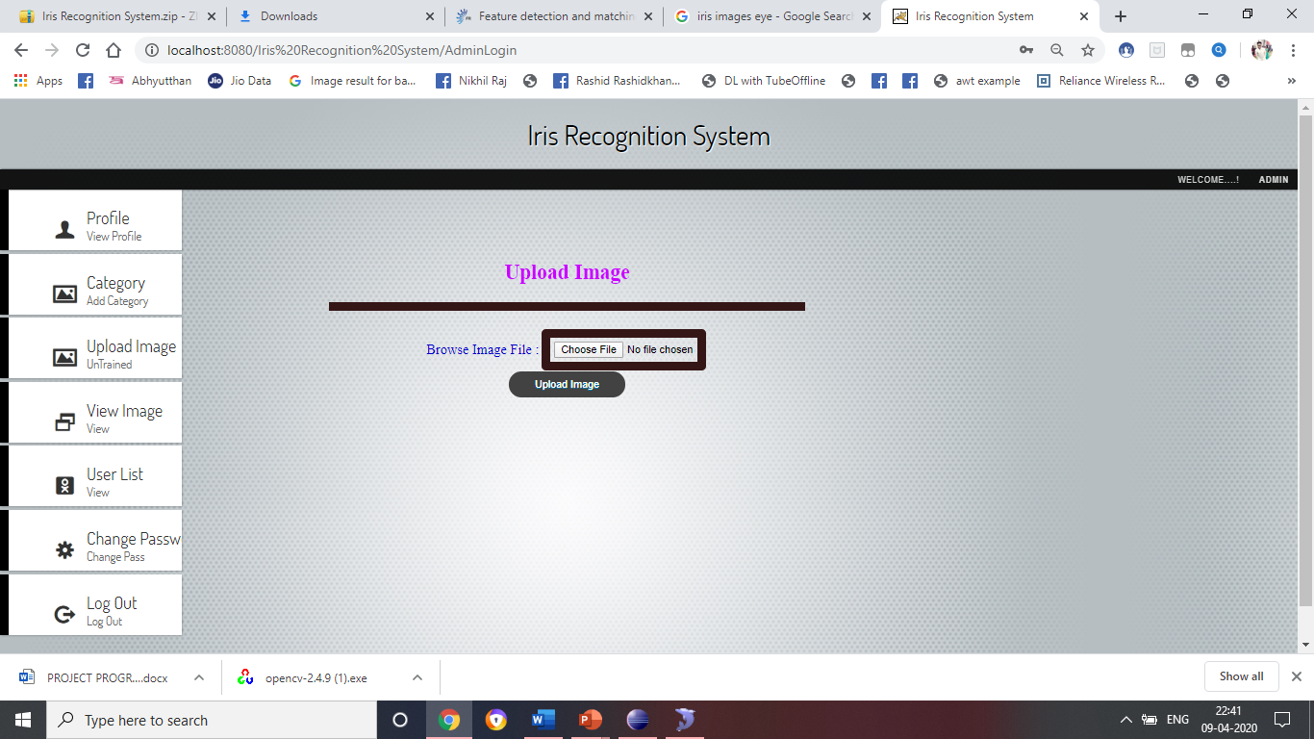

Slide 32
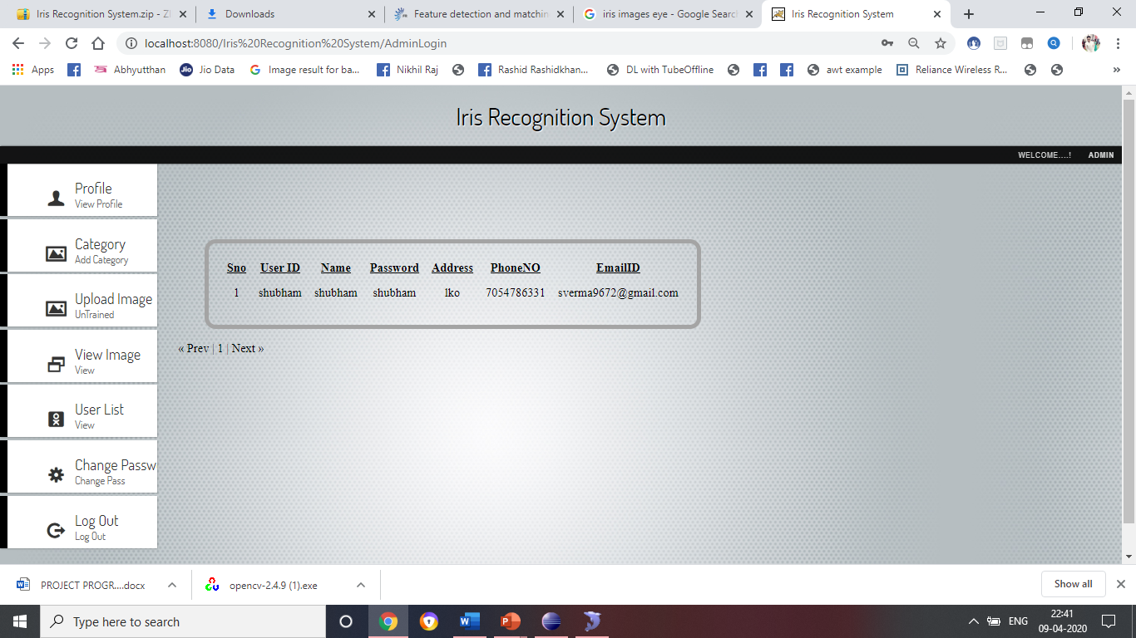

Slide 33
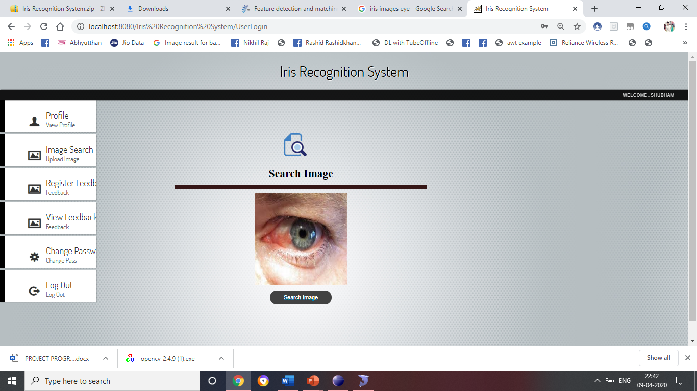

Slide 34


Slide 35
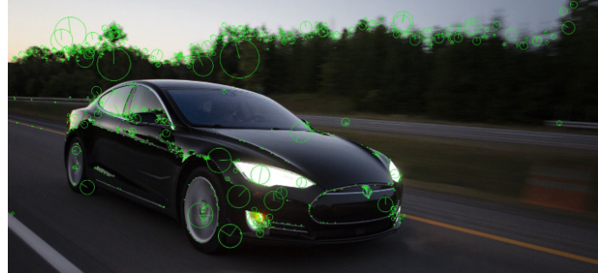
Open Cv 2.6.9
SIFT Algorithm : Scale Invariant Feature
Notes the intensities i1,i2,i3 at co-ordinates X,Y,Z
3 steps algorithm : Feature detector , Extractor , Matcher.
Feature Detector : Inliner , Outliner
Matcher notes the values and stores in matrix form.

Slide 36
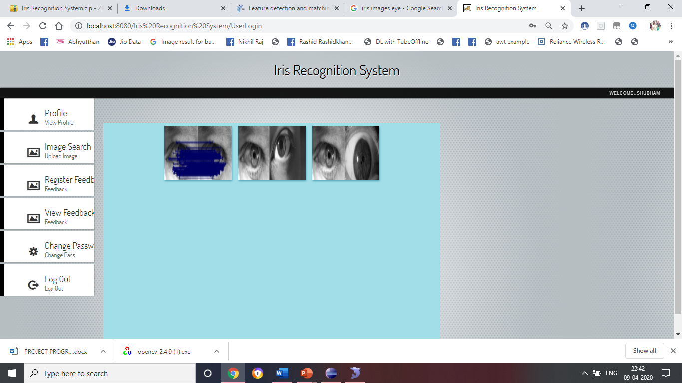

Slide 37
THANK YOU ……….

